Slide 1
Conductivity and non-commutative holographic QCD
M. Ali-Akbari
School of physics, IPM, Iran
Sixth Crete regional meeting in string theory
Milos, 2011

Slide 2
Outline
Conductivity from AdS/CFT
Sakai-Sugimoto model
2-1. Low temperature
2-2. High temperature
3. Conductivity
2-1. At low temperature
2-2. At high temperature

Slide 3
AdS/CFT
Strongly coupled gauge theory (QCD)
+ flavor
Gravity + D-brane
Supersymmetric background.
Confinment-Deconfinment phase transition.

Slide 4
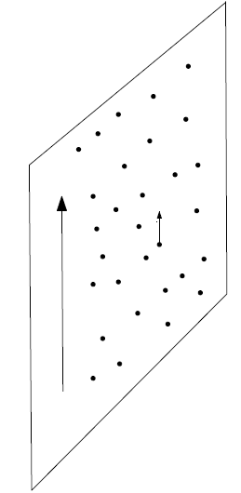
Gauge theory side
Gravity side
1. Strongly coupled thermal field theory.
2. Charge carriers introduced explicitly.
3. Electric filed.
4. Conductivity .
AdS Sch. BH
Time component of gauge field
on D7-branes ( ).
3. Spatial component of gauge field.
4.
Karch and A.O'Bannon,
“Metallic AdS/CFT,’’
[arXiv:0705.3870 [hep-th]].

Slide 5
Conductivity in
AdS Sch. Background
(Massless case)
Charge carriers thermally produced.
Charge carriers introduced
explicitly by
By setting , we still have conductivity.

Slide 6
Sakai-Sugimoto background
Low temperature
SS-model
Confined phase.
Chiral symmetry is broken.
Non-commutative
low temperature
SS-model
[1] T. Sakai and S. Sugimoto, ``Low energy hadron physics in holographic QCD,'‘ [hep-th/0412141].
[2] O. Aharony, J. Sonnenschein and S. Yankielowicz, ``A Holographic model of deconfinement and chiral symmetry restoration,'' [hep-th/0604161].

Slide 7
High temperature
SS-model
Deconfined phase.
Chiral symmetry is restored (intermdiate state).
Noncommutative
high temperature
SS-model

Slide 8
Conductivity
D8-branes
DBI action
Induced metric
and B-field
B-field in
background
Ansatz

Slide 9
Action
Equation of motion
for gauge field
Solution for
gauge field

Slide 10
Reality condition
and
conductivity equations
Root of the first
equation
Conductivity

Slide 11
Reality condition
and
conductivity equations
Roots
Conductivity
(Thermal case)

Slide 12
A more general
backgroud
Ansatz
DBI action

Slide 13
New ansatz
DBI action
conductivity equations
Roots
Conductivity

Slide 14
Commutative case
Non-commutative case

