Slide 1
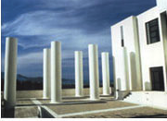
Multiplicities at LHC from BH Production
BNL.: 16th Dec, 2011
Anastasios Taliotis: Un. Of Crete, CCTP
Elias Kiritsis and Anastasios Taliotis Arxiv:[1111.1931]

Slide 2
Outline
Goals: State Problem/Facts from HIC
Tools: Relating AdS/CFT with Multiplicities
Introduction to TS, an example
Review of earlier works
Possible improvement ingredients: IR applied to several geometries
Digression: pQCD and the Saturation Scale Qs and weak coupling matching
Quantized, Normalizable Modes
Results, Data and Predictions
Conclusions/Future Work

Slide 3
Goals: State Problem/Data

Slide 4
Goal I.
Finish on Time

Slide 5

Goal II.: State Problem/Data
Heavy Ion Collisions:
isentropic evolution
from Yellow ➔Blue
[AdS approach:Kiritsis,Taliotis]
Stages of Collision
QGP and
hydrodynamic expansion
hadronic phase
and freeze-out
initial state
ISENTROPIC
pre-equilibrium
hadronization

Slide 6
Multiplicities N_{ch}
QGP and
hydrodynamic expansion
hadronic phase
and freeze-out
initial state
SW’s
S_{prod}
ISENTROPIC
pre-equilibrium
hadronization

Slide 7
N_{ch} from Confining and non-confining matter
Find
I. Conformal matter (AdS₅):
II. Confined matter:

Slide 8
Relating S with N_{ch}
1 Charged part. ÷ ½ Neutral part.
=> N_{tot} = N_{ch} + N_{neu} = 3/2N_{ch}
units of S [Heinz]
=> S_{prod}=5 × 3/2 × N_{ch} =7.5N_{ch}
Use N_{ch}, N_{tot}, S_{prod} interchangeably (proportional)
    N_{ch} = S_{prod}/7.5

Slide 9
Tools: Relating AdS/CFT with N_{ch}

Slide 10
AdS/CFT
Basic Result AdS/CFT:
            S_{ST} = S_{GT}
Conclude: Estimating S^{prod}_{ST}➔N_{ch}
Estimate S_{prod} using standard thms of GR
                [Penrose, Hawking, Ellis]

Slide 11
Introduction to TS

Slide 12
What this method does not: [Ads:,Albacete,Kovcegov,Taliotis;Romatscke,
Chesler,Yaffe,Heller,Janik,Peschanski…, Flat:D’Eath,Payne,Konstantinu,Tomaras,Spirin,Taliotis…]
What this method can do: S_{trap}≤S_{prod} . By reducing to unusual BV problem [Giddings,Eardly,Nastase,Kung,Gubser,Yarom,Pufu,Kovchegov, Shuryak,Lin,kiritsis,Taliotis,Aref’eva,Bagrov,Joukovskaya,...]
marginally
trapped
surface
[Picture from GYP]

Slide 13
Example: 4D Flat
Superimpose two
A/S solutions
Head On &

Slide 14
[Giddings & Eardley,03’]

Slide 15
Review Earlier Works

Slide 16
Shock Metric in AdS
AdS Dictionary:
BC of TS imply . Note presence
Then
[Gubser,Yarom,Pufu,Tanaka,Hotta]
[Gubser,Yarom,Pufu]

Slide 17
To check data must choose → Lattice [GYP]
N_{ch}~ s^{1/3} [GYP,08’] Data N_{ch}~ s^{1/4}. Indeed:
Lessons: (i) A brave effort absorb QFT complexities in a BV problem
(ii) Worth further investigation
Q: What is missing?
PHOBOS,
Arxiv:0210015
Plot:[GYP,08’]

Slide 18
Possible Improvement Ingredients

Slide 19
IR physics: Confinement
According data large fraction of particles produced low p_{T}~2-300 MeV~Λ_{QCD}. [CMS Col.]
Suggests possibility non-pQCD effects be important
Conclude: confinement may improve AdS/CFT results

Slide 20
IHQCD
Dilaton-Gravity Theories
[Gursoy,Kiritsis,Nitti,Mazzanti,Michalogiorgakis,Gubser,Nelore]
Appropriate scalar V’s and using
results
Where scale factors b(r) can be
Non-confining:
Confining:

Slide 21
Entropy from Uniform and Non-Uniform transverse profiles with or without confinement

Slide 22
Uniform Transverse Glueballs
Using BC & TS volume
Cases Analyzed:
I. Non-Confining
II. Confining
III. Confining
IV. Confining

Slide 23
Non-Uniform Transverse Glueballs
☐ϕ=δ(x-x’)
Cases Analyzed:
I. Power-Like
Confining
Non-Confining
II. Exponential
(Numerically)

Slide 24
_{Most S produced from UV}
Observation: According to AdS/CFT for classes of
b(r)’s most S produced in UV part of the TS
Argument:
Have shown
=> as E→large, then r_{UV}→0
Have
But integrand singular at UV
=> most S comes from UV
r_{UV}
r_{IR}
E₃
E₂
E₁
r’

Slide 25
At UV g<<1=> expect N_{ch}~small=> S ~small.
Maybe we should not used geometry where it breaks down
Way out? Incorporate weak coupling physics..
How?
Cut surface at r_{c1}(E)>r_{UV}(E) for all E [GYP]
But where exactly?

Slide 26
Digression: pQCD and Qs

Slide 27
Saturation Scale
Intuitive def: Qs is a trans. scale in nucleus color charge becomes dense
Free=interaction:
Strong classical gluon field⬄ g<<1,Q_{s}>>Λ_{QCD}
A_{μ} strong, then CGC theory applies and Q_{s} pertubatively; details:[Dumitru,Jalalian-Marian,Kovchegov,,BNL group: McLerran,Venugopalan,Khrazeev,…]

Slide 28
Cutting the TS
Propose cut TS at r_{s} ~1/Q_{s} provided r_{s}>r_{UV}
Effectively treat weak-strong coupling matching by step-function (see results follow)

Slide 29
Localized Transverse Distributions &
Quantized, Normalizable Modes

Slide 30
An Interesting Geometry:
normalized
Quantized Gravitons:
Then → finite pnomials
Normalizable:
Linear glueball trajectories: [Kiritsis, Mazzanti,Nitti]
[Kiritsis, Mazzanti,Michalogiorgakis,Nitti]

Slide 31
TS for the n=1 mode
Generally
Can show only C_{k}¹ contributes:
^{BC:} ^{(see results)}

Slide 32
n^{th} mode S_{trap}
Formulas adequate for numerical analysis

Slide 33
Recap
    N_{ch} = S_{prod}/7.5
    Several b’s* (conf. or not)=> several S_{trap}(s)
    None described data N_{ch} ~s^{1/4} or similar
    Most S comes from UV
    Cut TS at UV (i) E independent (ii) E depended Q_{s}
    Seen quantized, normalizable, graviton (sm)wave-functions. T₊₊ falls-off exponentially (K_{o})
*It is remarked that out of these geometries only AdS₅ reduces (trivially) to AdS₅ at the UV.

Slide 34
Results, Data & Predictions

Slide 35
Results .I
We have constracted exact (point-like J₊₊) shocks.
Exponential b’s with UV_{const} cut yield S_{trap}~ log²(s).
When b=(r/L)^{a=1} (confining) with UV_{const} cut yields S_{trap}~ s^{1/4} : fits data.
AdS geometry with unif. profiles produces least S_{trap}
In confining geometries only normalizable modes result a TS
Motivate a set of non trivial entropy inequalities,
Define:
GYP when b=L/r. T++ falls as power:~ 1/(x²+x²₀)³
IHQCD when b=L/r exp[-r²/R²].
Neither has UV-cut. Then *:
*It is remarked that both of these geometries reduce (non-trivially generally) to AdS₅ at the UV.

Slide 36
Results .II: Non trivial inequalities
Numerically or Analytically found:
I.
II.
III.
Dilute
Matter=>more S
Confined
Matter=>less S
>
>
>
>
>
>
Excited
Matter=>less S
Small Λ_{QCD}
=>more S

Slide 37
Results III. Attempt to Describe Data-Predictions (2 Geometries)

Slide 38
Geometry I. b=L/rexp[-r²/R²] no UV cut-off;n=1
Predictions PbPb (A=207): N_{ch}≈19100, 27000, 30500 for 2.76, 5.5 and 7 TeV respectively.
PHOBOS,
Arxiv:0210015
Interesting!
See ALICE
AuAu
PbPb

Slide 39
Geometry II. b=L/r with UV cut at c/Q_{s}
PHOBOS,
Arxiv:0210015
Predictions pp (A=1): N_{ch} ≈70, 110, 190, 260, for 0.9, 2.36, 7 and 14 TeV respectively.
Predictions PbPb (A=207): N_{ch}≈18750, 261800, 29400 for 2.76, 5.5 and 7 TeV respectively.
Interesting!
See ALICE
AuAu
Lattice;[GYP]
PbPb

Slide 40
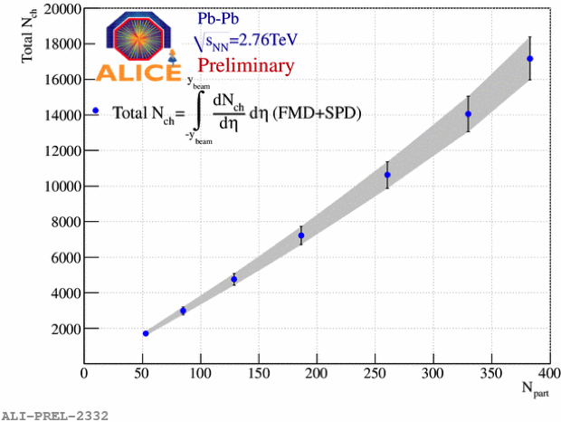
Alice Preliminary Results: 2.76 TeV
As collision gets more central (our case), data follow our curve better.
In particular: at A=190, we predict N_{ch}=17300!!!
ALICE,
Arxiv:1107.1973
Dashed line: Our theoretical curve as function of A at fixed s^{1/2}=2.76 TeV. Data Points: N_{ch}(N_{part/}/2).

Slide 41
Results III. Conclusions
Both treatments seem to describe data.
A more refined investigation required:
More careful matching with gravity parameters
More Data

Slide 42
Future Work….

Slide 43
Thank you
42

